Slide 1
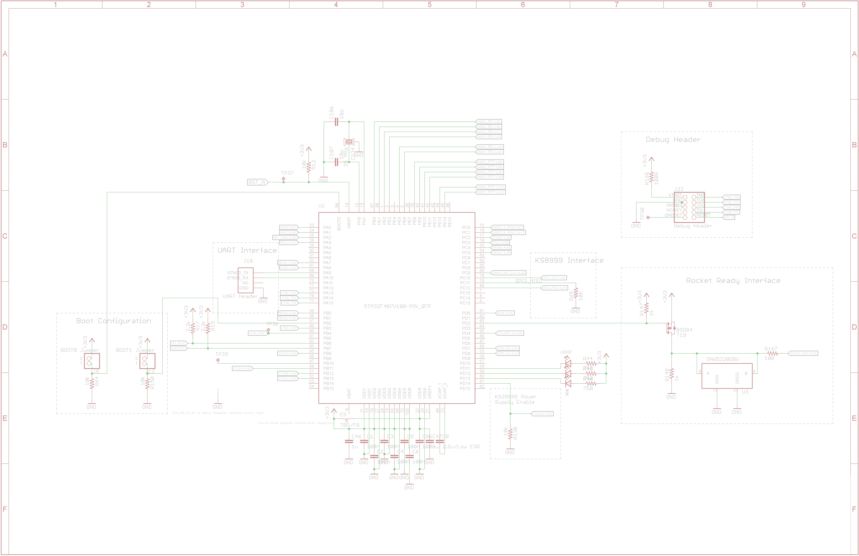
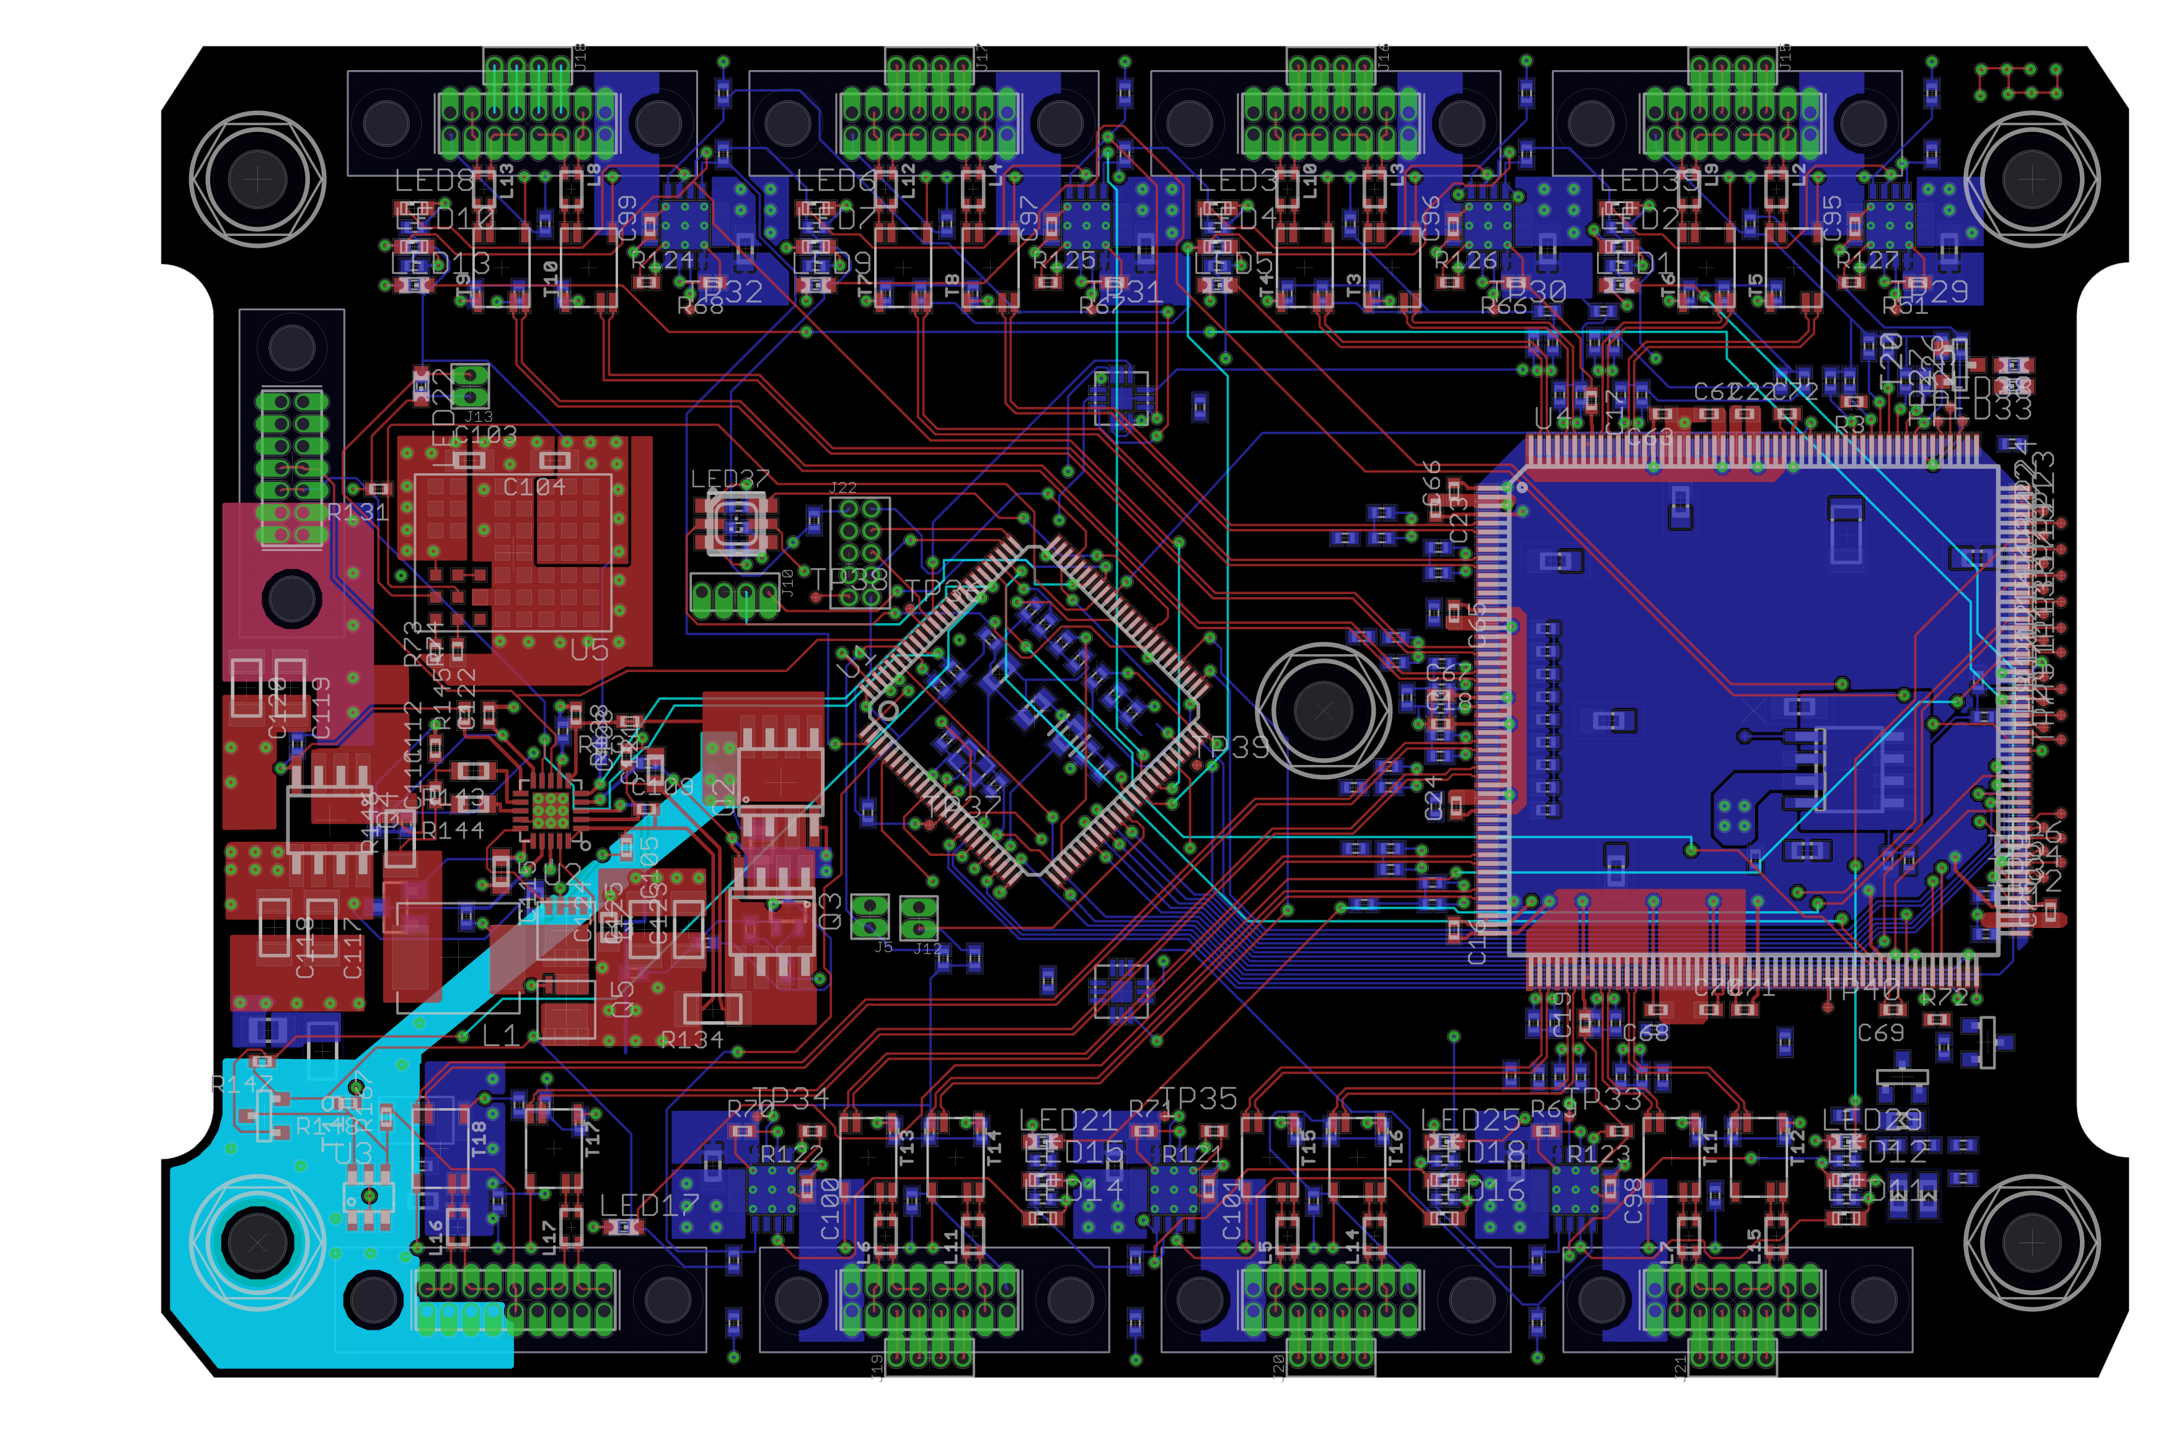
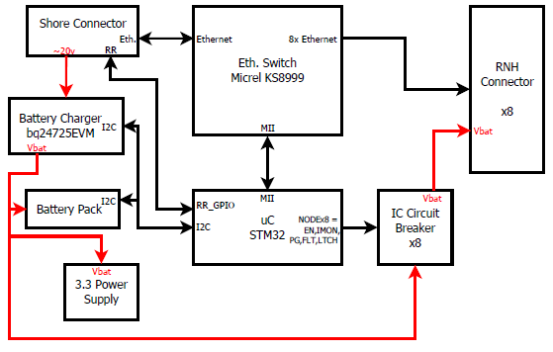

PSAS RocketNet Hub || Capstone 2012-2013
Sponsor---Andrew Greenberg | Members--Jackson Pugh---Michael Woodruff---JJ Hartley | Faculty Advisor---Dr. Richard Campbell
Overview
Portland State Aerospace Society designs and builds rockets with the objective of someday putting a satellite in orbit. It is divided into many subgroups. The avionics group is in charge of designing the brains of the rocket.
The project requested by PSAS was to design and layout an up-to-date power and data distribution board. This task required selecting effective, yet cost-efficient components including a switching power supply, Ethernet switch, and microcontroller.
Design
Data/Ethernet:
The Micrel KS8999, while the largest IC on the board, contains a 9-port Ethernet switch. It was picked to handle the main data communication because…
Microcontroller:
STMicroelectronics STM32F407 was selected to bootstrap the on-board peripherals and monitor the status in-flight…
Power Supply Regulation:
Linear Technology LTM8023 SPS was chosen…
Micrel 2V1 LDO was chosen…
Current Protection:
Power protection is handled by TI TPS2420 current switches.
Requirements
The board should contain the following:
Support at least seven independent nodes
Supply power with current-limited switches to each node
Distribute data over 10/100 Ethernet
Monitor and control sensors using a microcontroller
Low external component count for switching power supply
Low-power consumption when in standby mode
High-Level Block Diagram
RocketNet Power and Data Distribution Board Layout
Department of Electrical and Computer Engineering
†Background image is a screenshot of the STM32 microcontroller schematic in Eaglecad

